Slide 1
OpenEvolve for Uncorrelated Track Processing
Background Information for UCF Senior Design Project
SDA TAP Lab

Slide 2
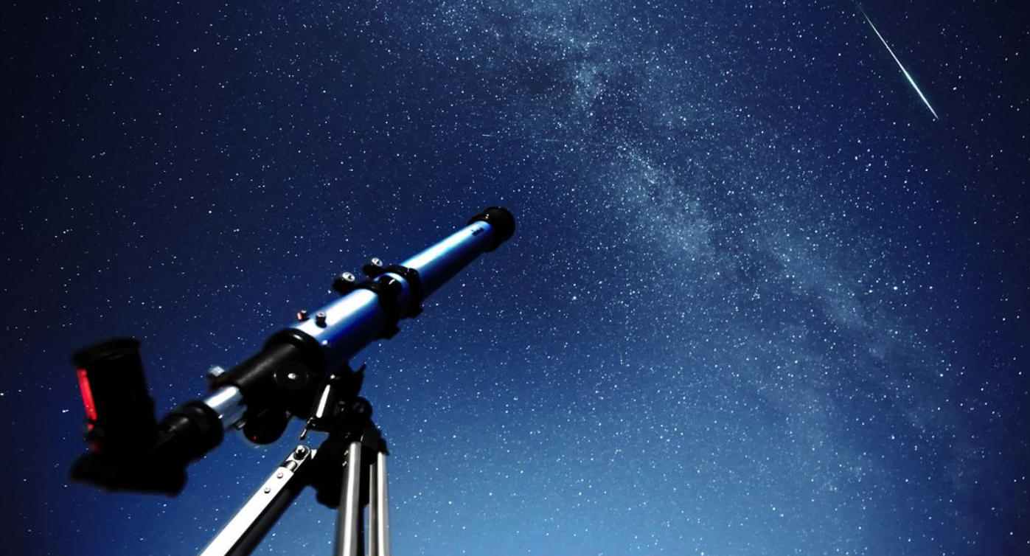
Uncorrelated Tracks (UCT) – What they are and why they matter
Do we know what this is?
Retrieved from: https://cdn.mos.cms.futurecdn.net/rU2TmB5aH6Uafd6sigNMeX-1200-80.jpg (July 2025)
Notes:
Measurement devices such as telescopes, radar, passive RF, etc. scan the sky for RSOs. Object will appear as a track, seen in the image When an object if found, its location is cross-referenced against a catalogue of known objects. Sometimes, the tracks do not correlate to any known objects. These are referred to as Uncorrelated Tracks, or UCTs. UCTs present an issue for SDA because it represents an object in space that we don’t know what it is. It might pose a threat to our space infrastructure.

Slide 3
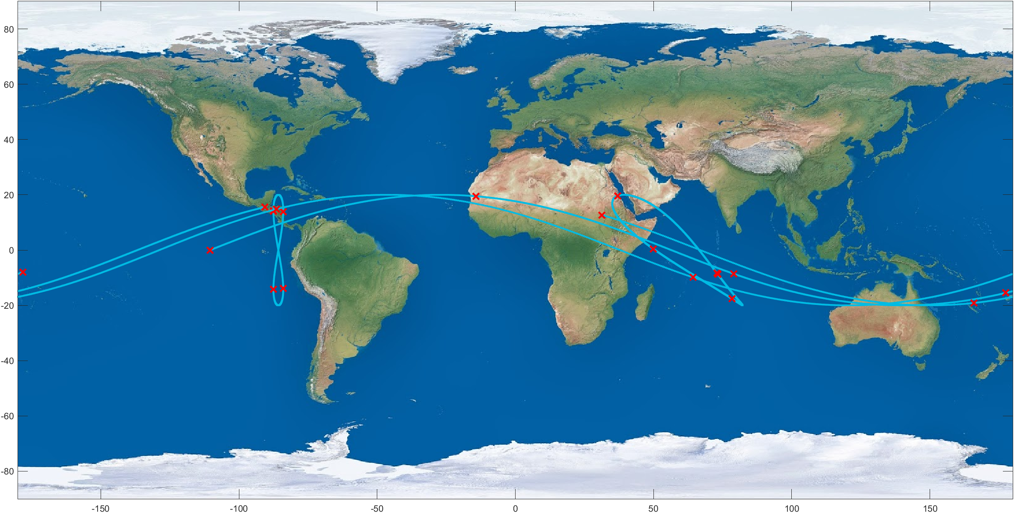
Uncorrelated Track Processing (UCTP)
Inputs:
List of UCTs
Outputs:
Orbital Estimate
List of observations corresponding to that orbit
Notes:
Ground Traces shown is only 4 satellites, and already there are many observations that lie on top of eachother. It's obvious to see how this is a difficult problem to solve, but there is a separate, more nuanced issue associated with UCT processing. When someone presents a UCT solution, how do we know how accurate it is? By definition, there is no known solution to compare to.

Slide 4
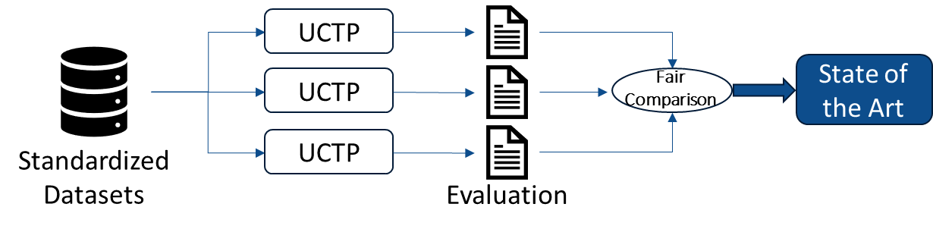
Benchmarking and Evaluation - The Common Task Framework
A common task framework has three components
“A publicly available training dataset involving, for each observation, a list of (possibly many) feature measurements, and a class label for that observation
A set of enrolled competitors whose common task is to infer a class prediction rule from the training data
A scoring referee, to which competitors can submit their prediction rule. The referee runs the prediction rule against a testing dataset which is sequestered behind a Chinese wall. The referee objectively and automatically reports the score (prediction accuracy) achieved by the submitted rule.”
- David Donoho. 50 Years of Data Science. September 2015
Notes:
The Common task framework is a structured method for evaluating and comparing different solutions to the same problem. CTF commonly used in data science, machine learning/AI, image recognition, etc. to accelerate advancements in state-of-the-art. As defined by Donoho in landmark paper 50 years of data science, CTF has …. We want to bring elements of the CTF to SDA, by providing an objective way to evaluate performance of different predictive algorithms, and highlight where these algorithms are deficient/identify where they need to improve. Our specific task for this summer was to benchmark and evaluate UCT processing algorithms, with the idea being to create the framework to be generalized to other areas of SDA.

Slide 5
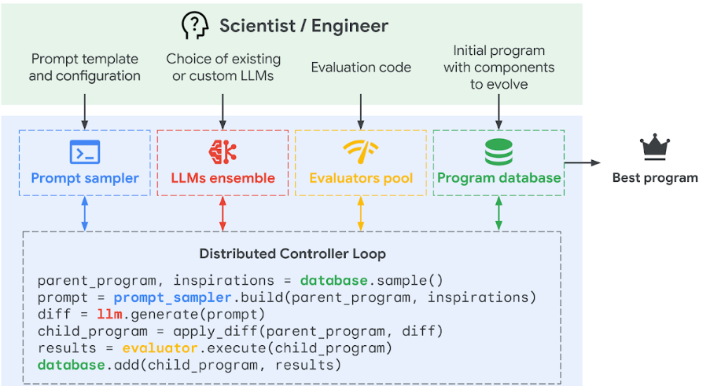
UCT Processing and OpenEvolve
Retrieved from: https://deepmind.google/discover/blog/alphaevolve-a-gemini-powered-coding-agent-for-designing-advanced-algorithms/
Notes:
Google Deep Mind has developed a new AI agent for optimizing coding applications through an iterative process of querying LLM models via API based on a user defined prompt to suggest improvements to a given function. The suggested improvements are then evaluated against some user-defined scoring metrics to determine whether improvements were actually made, and the best function at every iteration is saved to be the new target of improvement. After many iterations of manipulation and evaluation, an optimized ‘best program’ is output by the software. Google Deep Mind has already demonstrated success with AlphaEvolve, improving current state-of-the-art for certain classes of matrix multiplication algorithms.
There is an open-source version of AlphaEvolve, called OpenEvolve, which works in a very similar way. It is intended to use our benchmarking and evaluation pipeline in the evaluation function required by the OpenEvolve architecture and attempt to iterate on existing UCTP algorithms to identify areas of improvement for current state-of-the-art to enhance SDA capabilities.

Slide 6
Data Set Generation

Slide 7
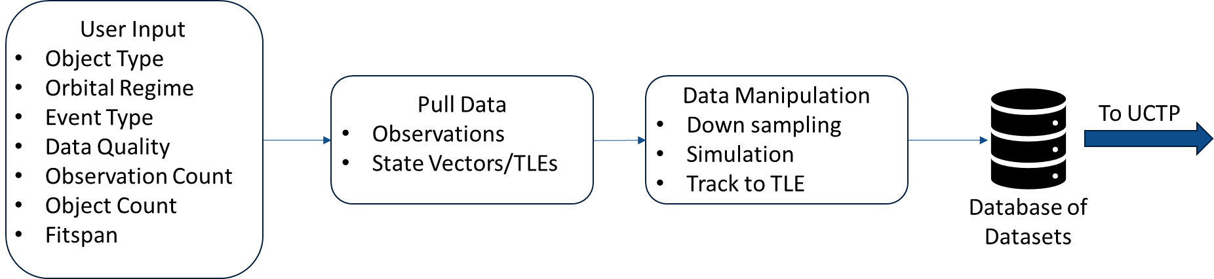
Dataset Generation Workflow
Notes:
Basic dataset generation workflow, we first allow the user, whether it is the developer of UCTP or a 3rd party evaluator, to select the desired characteristic of the dataset used to test. There are different options, such as object type, orbital regime, and data quality. We then go find the data that best matches the user-defined specifications, which becomes our reference objects and reference orbits, and perform any data manipulation necessary. If there is too much data and the user desires a sparser dataset, we will selectively downsample the data. If there is too little data, we will simulate observations to achieve the desired result. We will also convert the raw observations to trackTLEs. All of that information is then saved as the benchmark dataset, which is saved in a database. Any one of these datasets is then what is fed into the UCTP.

Slide 8
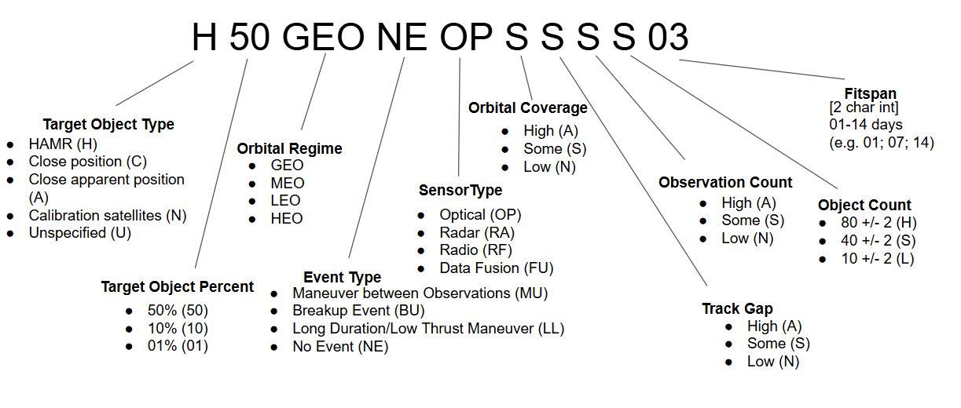
User Input - Dataset Code
Notes:
Dataset code is a unique 16 character string encoding the user selected data parameters.

Slide 9

Unified Data Library
UDL contains data collected from various public/private sources
Available data includes TLEs, raw observations (RA/Dec), state vectors with covariance, etc.
Built-in API allows for automated dataset updates
Used known catalogued satellite data from UDL as “truth” reference
Data is de-correlated to simulate UCT data before being fed to the UCTPs
Reference is stored in answer key for later evaluation
Retrieved from: https://catalystcampus.org/programs/ (July 2025)

Slide 10
Benchmark Datasets and OpenEvolve
Automated pipeline has the ability to generate and evaluate on many different benchmark datasets depending on user configuration
This is to ensure robustness in the evaluation
We want our OpenEvolve architecture to share the same robustness
What is the best way to do this

Slide 11
Evaluation/Packaging

Slide 12
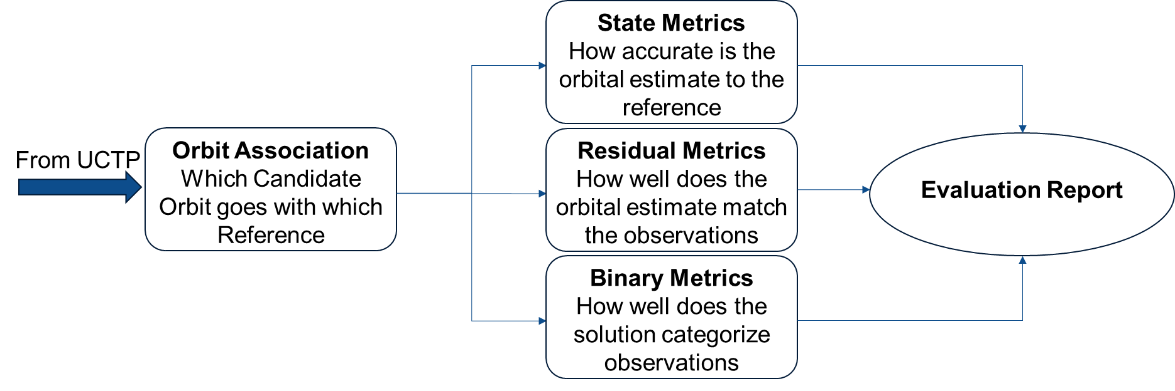
Evaluation Workflow
Notes:
segue into force model

Slide 13
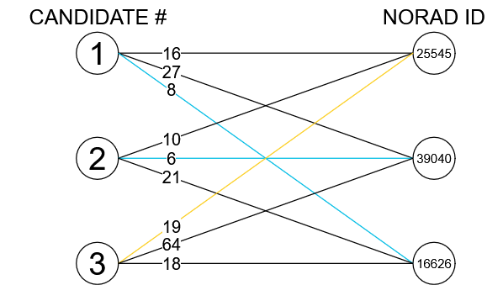
Orbit Association
Assume the UCTP does not check objects vs catalog
Need to “match” candidate results to references
Use Hungarian Algorithm (scipy.optimize.linear_sum_assignment)
Minimize norm of error vector
Created using drawio.com

Slide 14
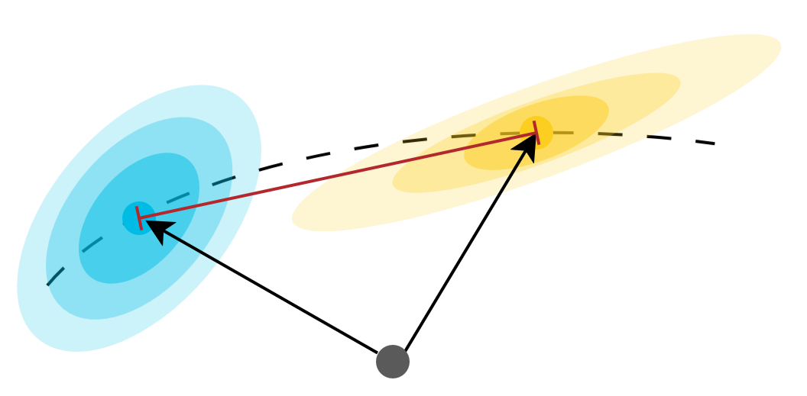
State Metrics
Propagate each reference to candidate and compare state vectors
Error Norm: How physically close are the vectors?
Bias: Is the UCTP candidate off in a consistent manner?
Mahalanobis P-score: How likely is it that the vectors correspond to the same orbit?
Normalized Estimation Error Squared: How confident is the processor in its results?
Created using drawio.com
Notes:
MILES STARTS

Slide 15
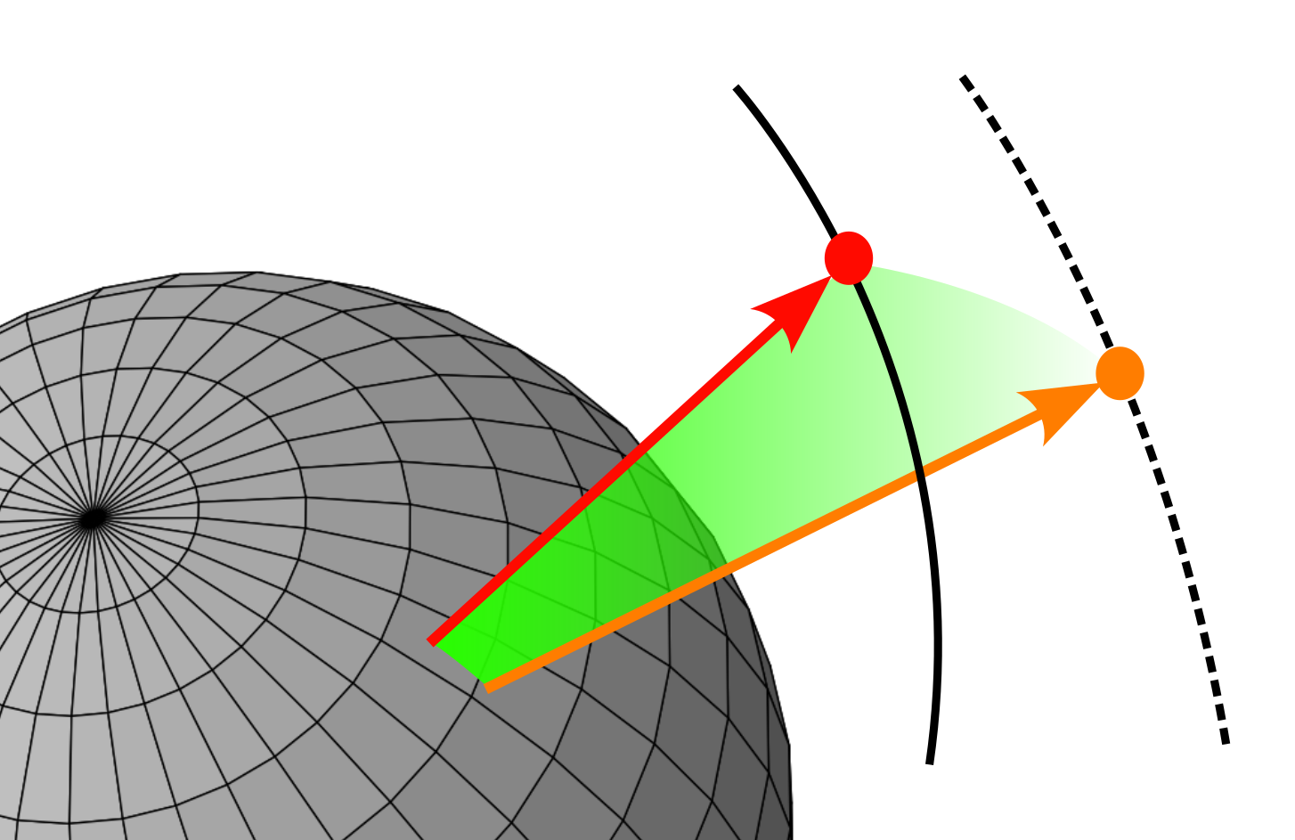
Residual Metrics
Computes the unit circle great arc residual between two sets of angular observations
Gives a measure for the accuracy and precision of the UCTP
Accuracy: compares the reference orbit observations / trackTLEs with the UCTP candidate orbital estimation
Precision: compares the UCTP candidate orbit observations / trackTLEs with the UCTP candidate orbital estimation

Slide 16
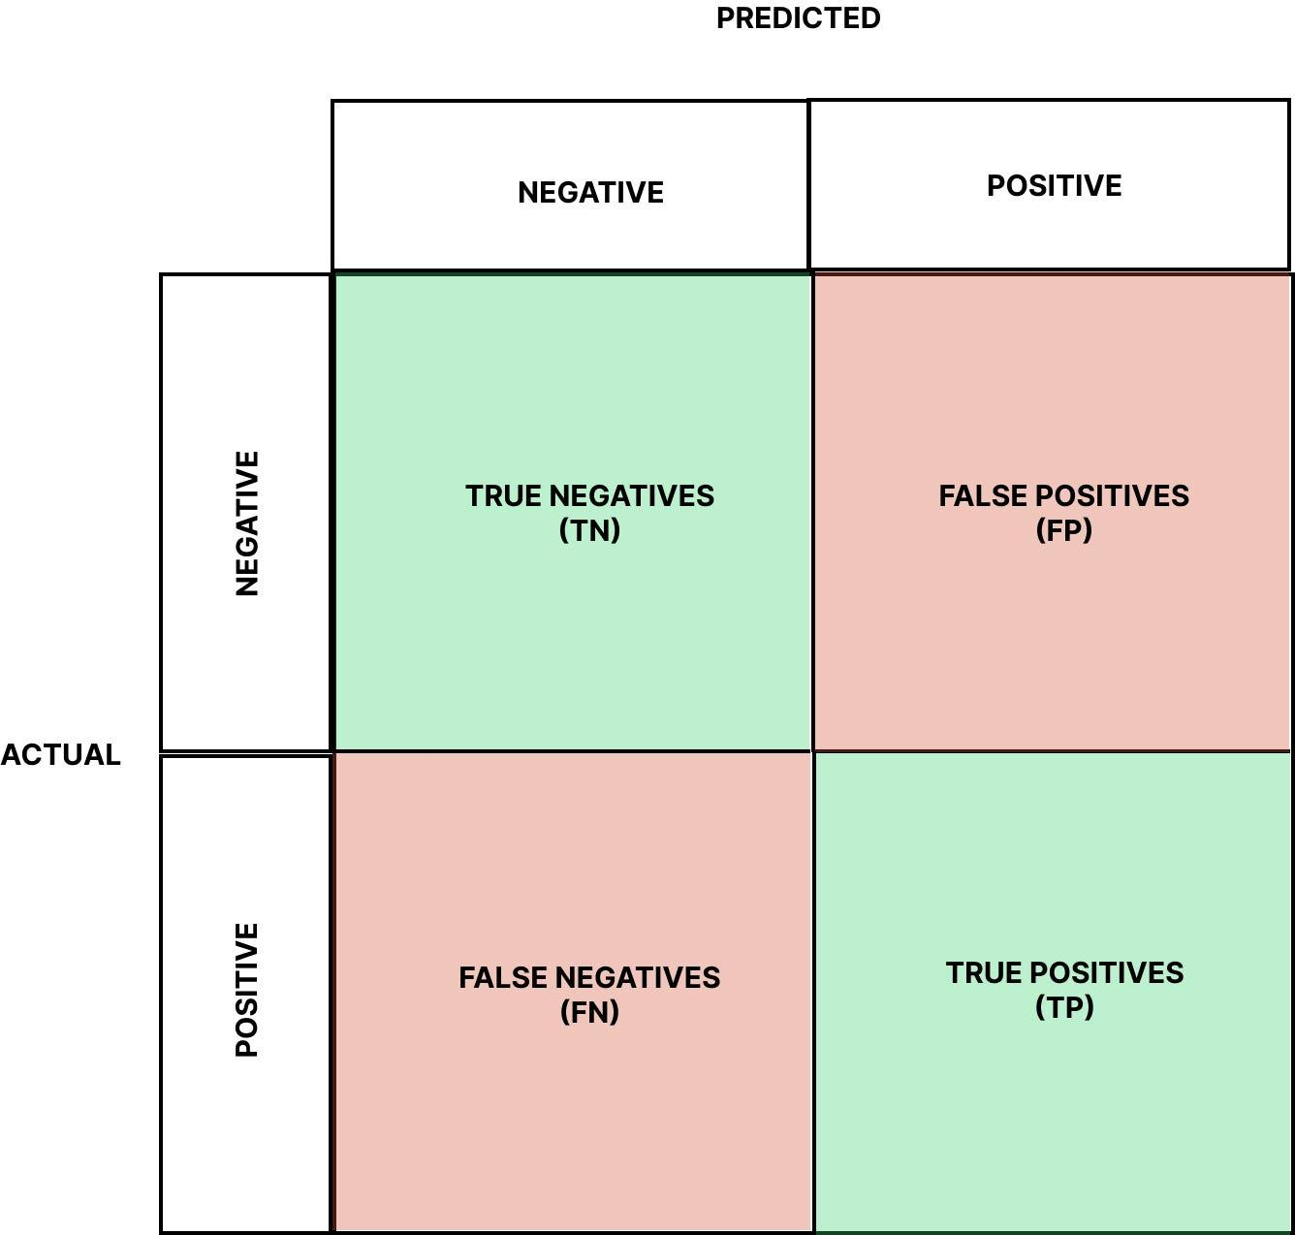
Binary Metrics
True Positive (TP): Observation or TrackTLE belongs to both the Candidate Orbit and the Reference Orbit to which it has been associated
True Negative (TN): Observation or TrackTLE does not belong to any Candidate Orbit or Reference Orbit
False Positive (FP): Observation or TrackTLE belongs to a Candidate Orbit but not the Reference Orbit
False Negative (FN): Observation or TrackTLE does not belong to a Candidate Orbit but does belong to the Reference Orbit
Retrieved from: https://medium.com/data-science/the-explanation-you-need-on-binary-classification-metrics-321d280b590f (July 2025)
Notes:
Observations can be classified in one of four categories, depending on if they were associated correctly or incorrectly. A True positive is when an observation is correctly associated with the appropriate reference object. A true negative is when an observation is correctly not associated with any reference object. A False positive is when an observation is incorrectly associated with a reference object, and a false negative is when an observation is incorrectly not associated with any reference object.
True Positive (TP): Observation or TrackTLE belongs to both the Candidate Orbit and the Reference Orbit to which it has been associated
True Negative (TN): Observation or TrackTLE does not belong to any Candidate Orbit or Reference Orbit
False Positive (FP): Observation or TrackTLE belongs to a Candidate Orbit but not the Reference Orbit to which it has been associated
False Negative (FN): Observation or TrackTLE does not belong to a Candidate Orbit but does belong to the Reference Orbit to which it has been associated
Compare The Observations/TrackTLEs associated by the UCTP
Leads to many more secondary values used to classify the results:
F1 Score
Cohen’s Kappa Coefficient
Matthews Correlation Coefficient

Slide 17
Overall Score Metric
For evaluator.py: function evaluate(program_path):
returns dict {“binary”: val, “residual”: val, “state”: val, [other relevant metrics]: [values],
“overall score”: [some combination of individual metrics]
Identify any other relevant metrics (e.g. run time, reproducibility, scalability, etc)
(low priority)
Find best way to combine metrics to give comprehensive evaluation score
(high priority)
Return artifacts from evaluator to LLM sampler
(med priority)

Slide 18
Side Project:
Orbital Events Labelling

Slide 19
Space Event Data Labeling (not yet implemented)
Ground truth is essential for reliable algorithms and machine learning operations that look to characterize space events
NOTSO notifications (Notice to Space Operators) assist us building standardized datasets to assist in this endeavor
Our pipeline to takes these text-heavy, human-entered events and provides a space event label and builds time event window to gather observation data that is associated with the event
Future engineers will use this packaged data to train algorithms to classify, detect, and characterize events in space
Notes:
Finding ground truth in space is very hard to do for a multitude of reasons; noisy sensor data, fragmentation of observations and reporting, data silos and confidentiality, lack of standardization and continuity of defining space events. If we intend to tackle the characterization, detection, and classification of space events using machine learning, finding a way to derive some truth from the ground truth data we do have is essential.
NOTSOs (Notice to Space Operators) are notifications from the Joint Commercial Operations that state when a known entity or entities has done something; made a maneuver, executed a rendezvous, created a breakup, launched from from a particular site. Right now this one of the most reliable sources reporting events that happen in space.
The problem is that these notifications are text-heavy, human-entered, semantically-rich and have a large amount of variance in how each type of event is reported over time, and is most likely to change in the future.
Our pipeline uses a combination of natural language processing (text classification) and software engineering to extract insights from the text-heavy event such as date/times, satellite numbers an provides the event with one of the 82 space event labels curated by subject matter experts the space domain.
From there we are able to build a time window around that event which is used to gather observation data that will assist in contextualizing the event. All of this data is then packaged and formatted for space operators.
The value of this is that future engineers now have labeled ground truth data which can be used train algorithms to characterize, classify, and detect events in space.
My team will be giving a full length presentation on this topic August 6th if you are interested in learning more about the project

Slide 20
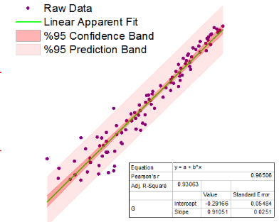
Curve Fitting Example
Exact Analytic solution
Linear Least Squares
Modern state-of-the-art
Scipy.optmize
Can OpenEvolve achieve state-of-the-art?
Process:
Develop metrics: how to evaluate quality of fit (RMSE), others? (runtime/reproducibility,etc)
Initial program: try different things, see what works
Evalutor.py: what are the critical features
Config.yaml: try different things, see what works
Output(s): Best program, performance over evolution, others?
Retrieved from: https://www.originlab.com/index.aspx?go=Products/Origin/DataAnalysis/CurveFitting

